Slide 1
The Impact of Meat Consumption on Methane Emissions
Data for Years 1990- 2012
Rachael Amick, Andrew Hardy, Kara Kirby and Aygul Matyakubova

Slide 2
Carbon dioxide (CO₂) is a naturally occurring gas that is essential for life. CO₂ is important for sustaining a habitable temperature for the planet. It is estimated that without these gases, the average surface temperature of the Earth would be about -18 degrees Celsius (-.4 F)¹. Levels of CO₂ have been rising steadily since the start of the Industrial Revolution.

Slide 3
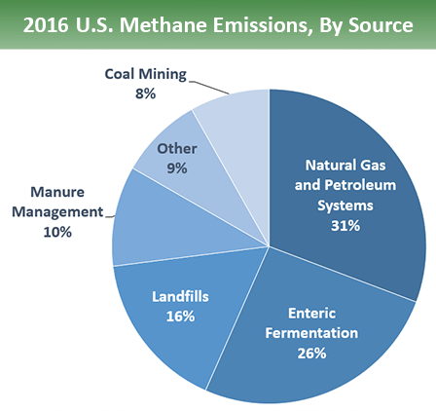
While carbon dioxide is typically painted as the bad boy of greenhouse gases, methane is roughly 30 times more potent as a heat-trapping gas.² Methane is a naturally occurring organic compound, but human activity has increased the amount of greenhouse gas in the atmosphere. In 2016, methane accounted for about 10 percent of all U.S. greenhouse gas emissions from human activities.

Slide 4
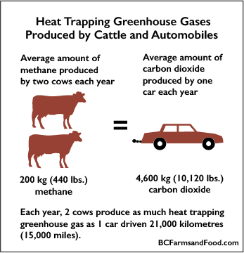
According to the United Nations Food and Agriculture Organization (UNFAO), agriculture is responsible for 18% of the total release of greenhouse gases worldwide, more than the whole transportation sector. Methane from livestock accounted for 39% of all greenhouse gases from agriculture. The EPA lists the following agricultural activities as the top contributors to methane emissions: - Application of synthetic and organic fertilizers - Drainage and irrigation practices - Methane released in livestock digestive processes, also known as enteric fermentation - Manure treatment and storage methods

Slide 5
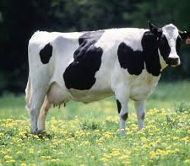
The UNFAO lists cows as the top contributor of methane emissions in the agricultural sector. It is estimated that one cow will release 30-50 gallons of methane gas per day during their natural digestive processes. There are an estimated 1.5 billion cows on Earth.

Slide 6

We are going to compare the year over year methane emissions from 1990-2012 with rates of beef consumption for the same period to draw a correlation between the two. We narrowed our research areas to the following countries:
Argentina Australia Brazil Canada China
India Indonesia Russia Switzerland United States

Slide 7
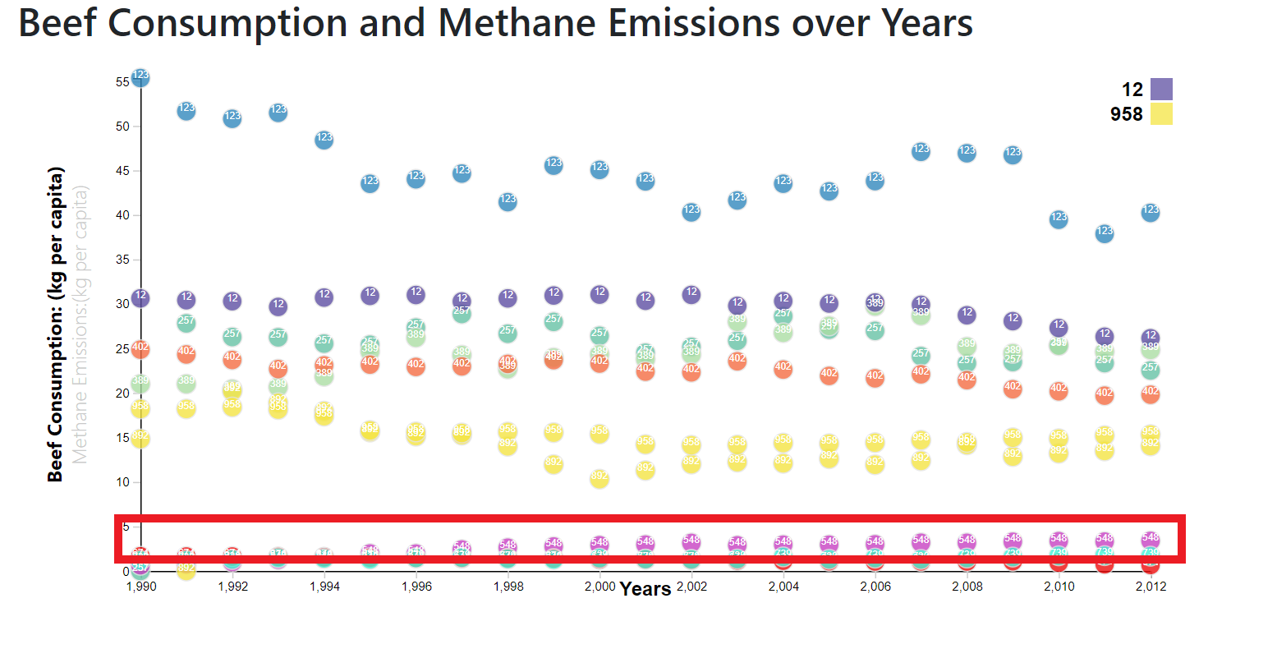
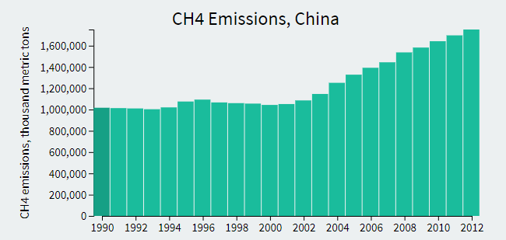
Our research supports the theory that there is a correlation between meat consumption and increased methane emissions, as shown with the data for China. The rate of beef consumption increased in the period reviewed and methane emissions also increased.

Slide 8
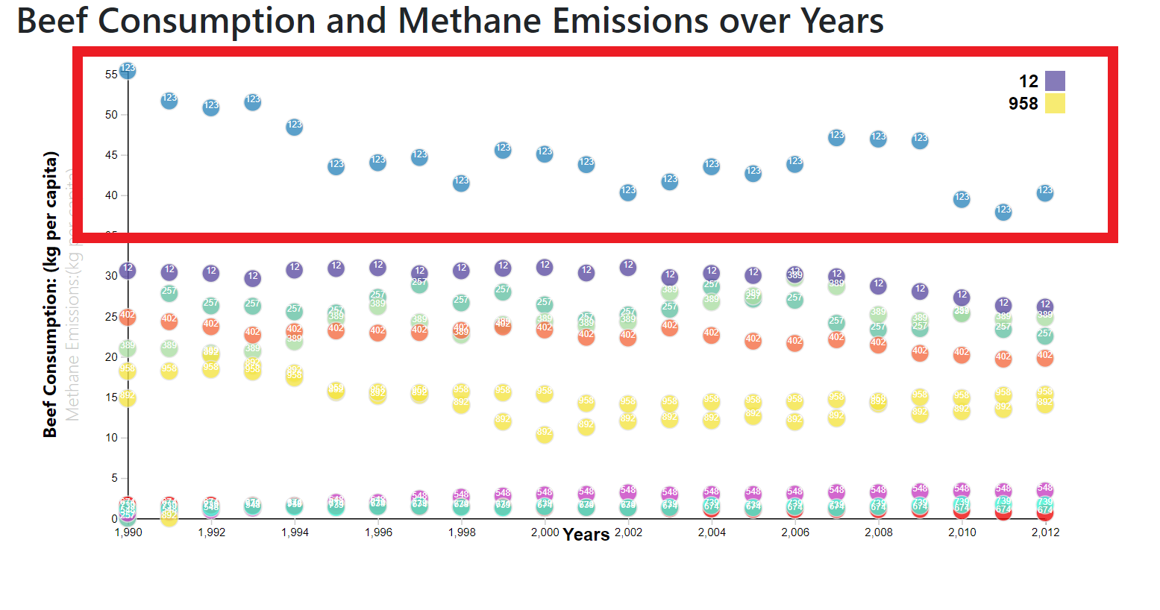
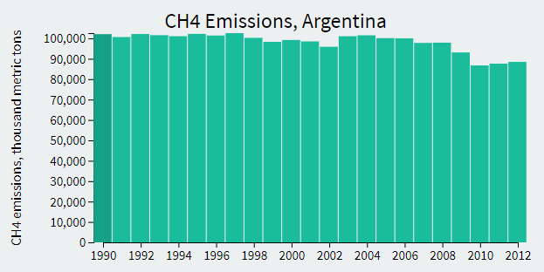
Conversely, Argentina was able to reduce their methane emission levels while reducing their overall beef consumption.

Slide 9
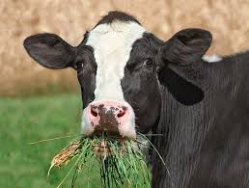
Following the passage of a law in California that requires the reduction of methane emissions and other air pollutants by 40 percent by 2030, the California Air Resources Board ordered a majority of the reductions to come from the diary industry. But the reductions won’t come from less meat consumption, but from changing the food livestock are fed. A UC Davis study participant was able to reduce the methane produced by enteric fermentation by almost 50 percent by changing his cattle’s diet to seaweed and molasses. Another study out of Texas is showing reduction in emission levels when a probiotic was added to cattle feed.

Slide 10
Reducing worldwide methane emissions does not rest solely on the meat industry’s shoulders. Most methane levels are created by human activities such as oil and gas production, waste management and transportation. The Paris Agreement on climate change is aiming to reduce the global temperature by 2 degrees Celsius of pre-industrial levels. The countries involved in the Paris Agreement are committed to making changes in these areas that result in a lower carbon footprint.

Slide 11
¹ https://ourworldindata.org/co2-and-other-greenhouse-gas-emissions ²https://blogs.princeton.edu/research/2014/03/26/a-more-potent-greenhouse-gas-than-co2-methane-emissions-will-leap-as-earth-warms-nature/ https://data.worldbank.org/indicator/EN.ATM.METH.KT.CE?view=chart https://data.oecd.org/agroutput/meat-consumption.htm
Sources

Slide 12
Data Sources
Greenhouse gas emissions data from the World Bank
Meat consumption data from the OECD

Slide 13
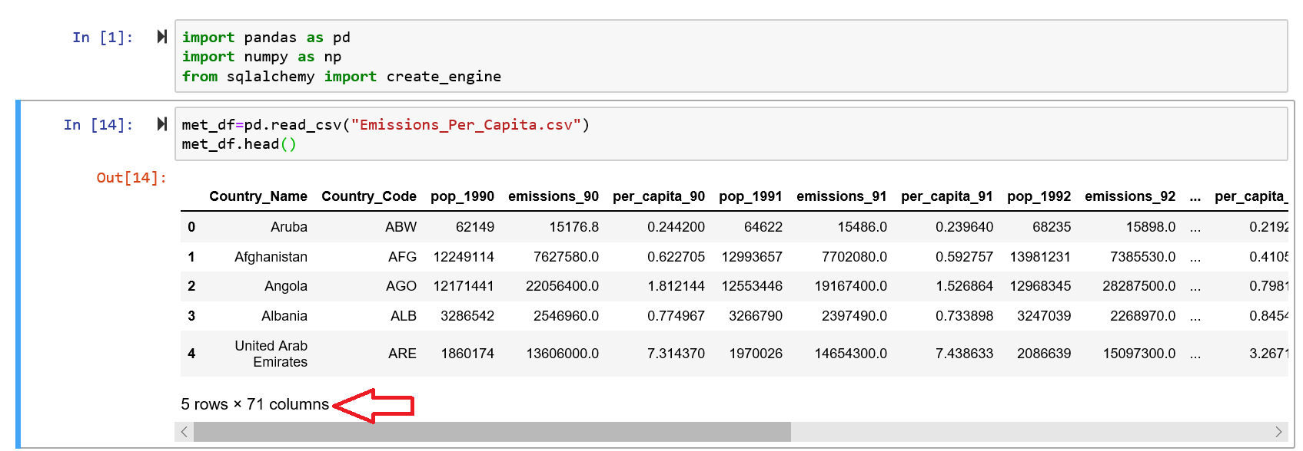
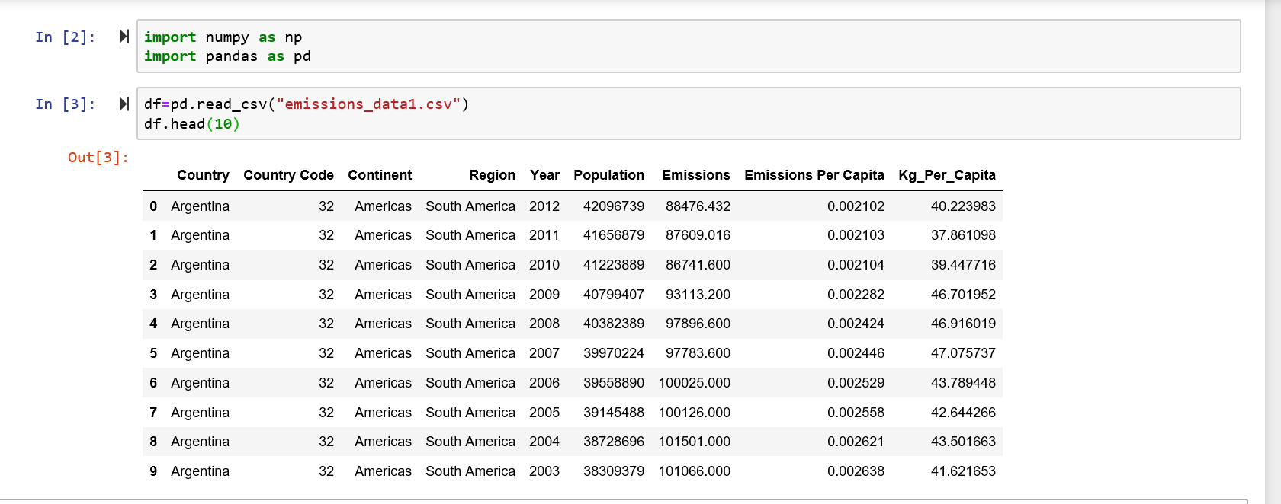
Data Cleaning – We used pandas to clean up the original csv files in the format we needed

Slide 14
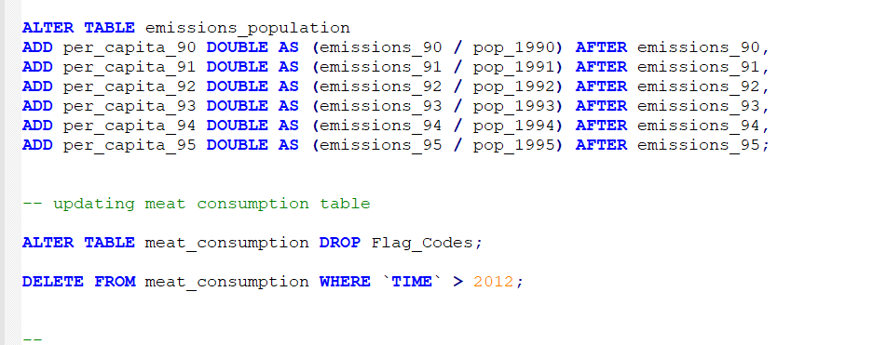
SQL Data Clean Up

Slide 15
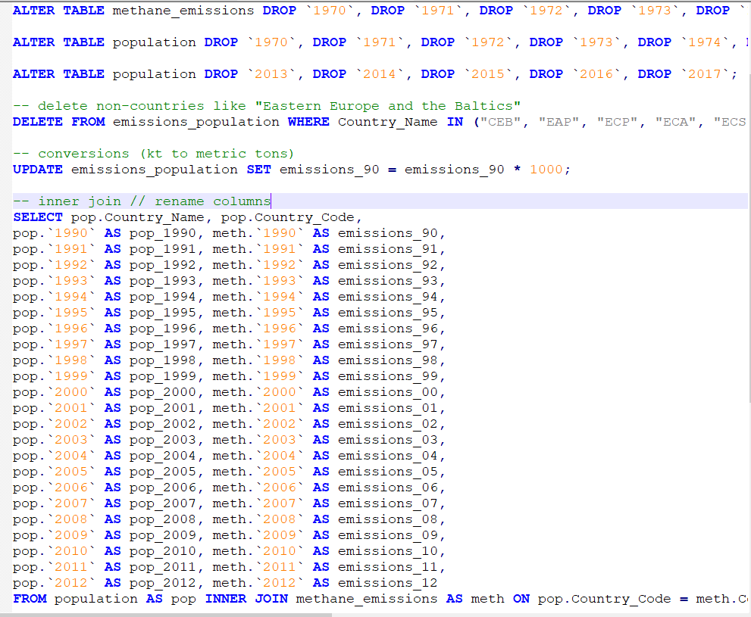
SQL Data Clean Up

Slide 16
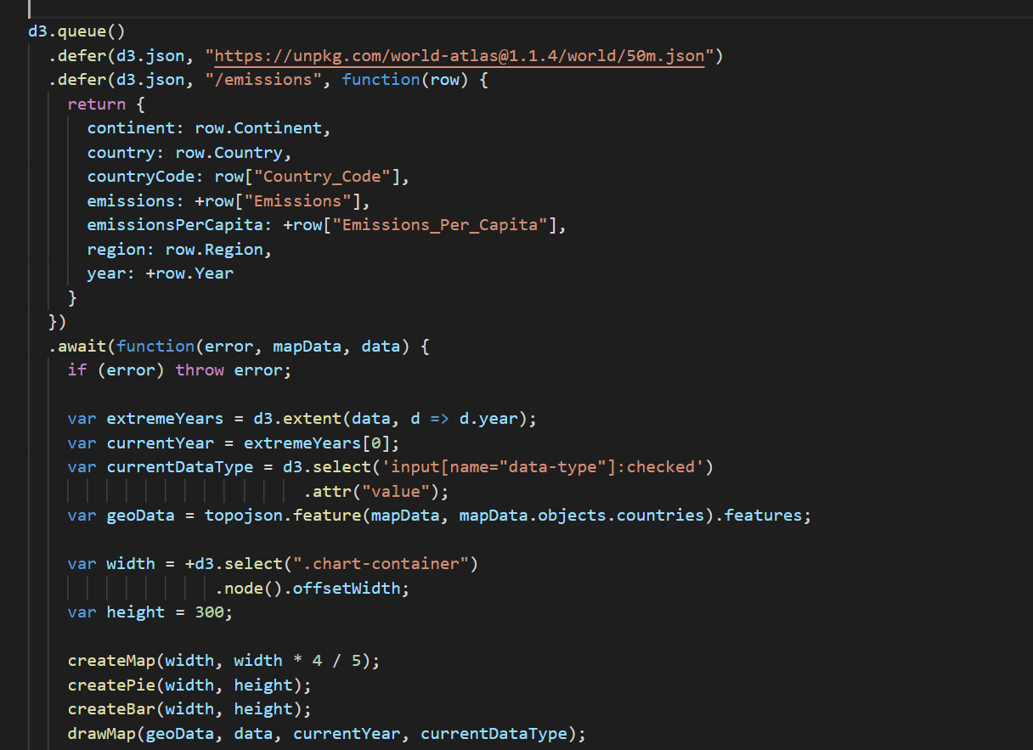
d3 Code for Master App Data

Slide 17
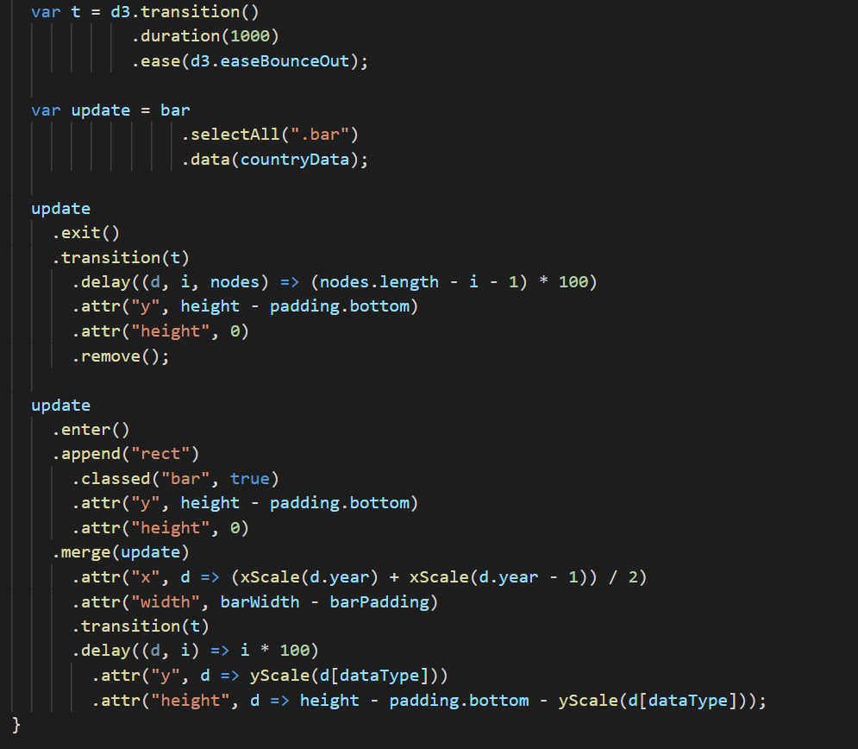
d3 Code for Bar Graphs

Slide 18
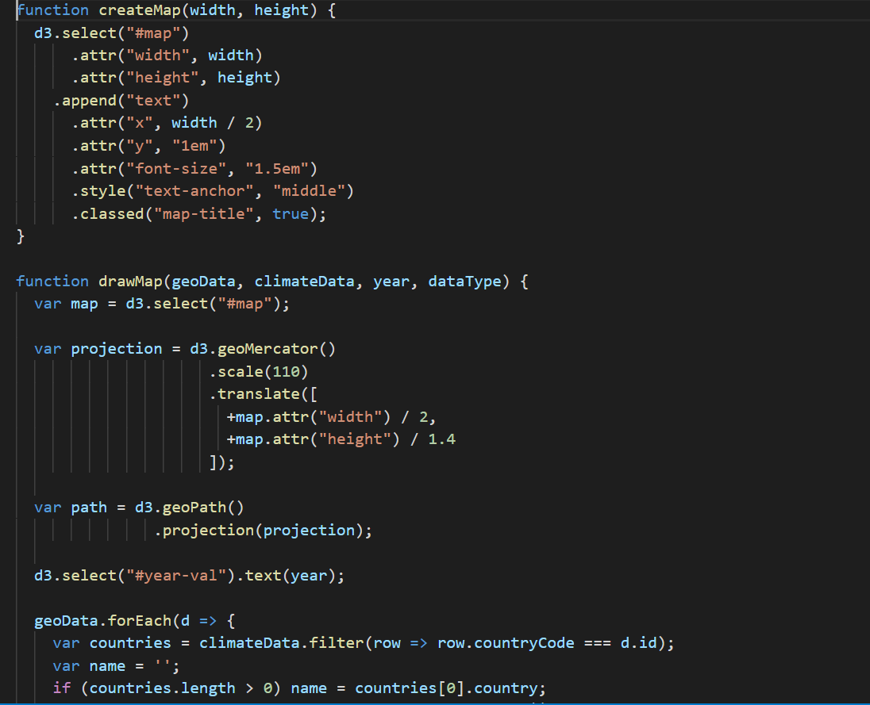
d3 Code for Maps

Slide 19

d3 Code for Pie Charts

Slide 20
Future Research
Which policies are most effective at reducing methane emissions from livestock?
To what extent do animal genetics and nutrition influence the amount of methane produced?
What is the relationship between economic stability and methane emissions?

